Slide 1
Properties eda and ml
Khoa Truong

Slide 2
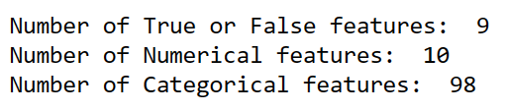
Number of features for this dataset
True_False features: 'isSeniorCommunity', 'hasAssociation', 'hasPrivatePool', 'hasGarage','hasAttachedGarage', 'hasCarport', 'hasSpa', 'hasFireplace', 'isNewConstruction’.
Numerical features: 'monthlyHoaFee', 'liv/lot_ratio', 'bedrooms', 'carportSpaces', 'garageSpaces', 'coveredSpaces', 'parking', 'bathroomsHalf', 'bathroomsFull', 'fireplaces’.
Categorical features: levels, laundry, flooring, construction, exterior, interior, appliances, foundations, lot, security Features, sewer of the house.
After one-hot encoding with categorical features, we have 117 features for ML/DL

Slide 3
Living price
How can we define living price?
If living/lot_area ratio < 1, then living price = living/lot_area ratio * price
If living/lot_area ratio >= 1, then living price = price
This is the target variable for this model

Slide 4
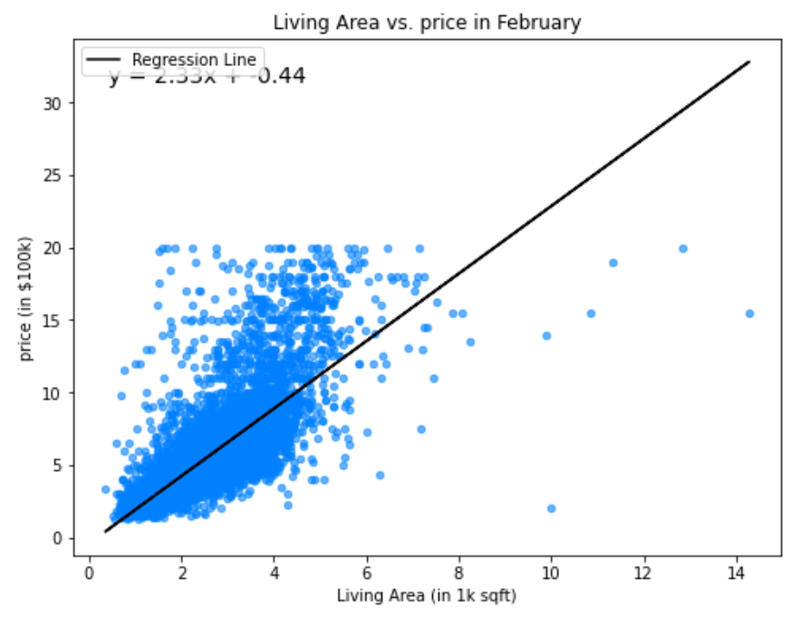
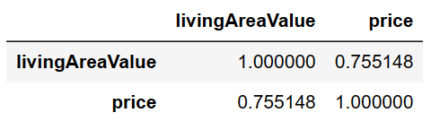
Living Area vs. Price in february

Slide 5
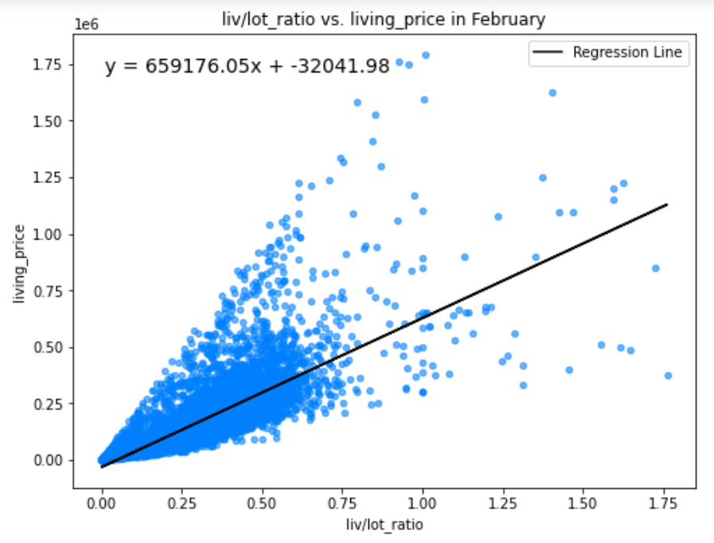
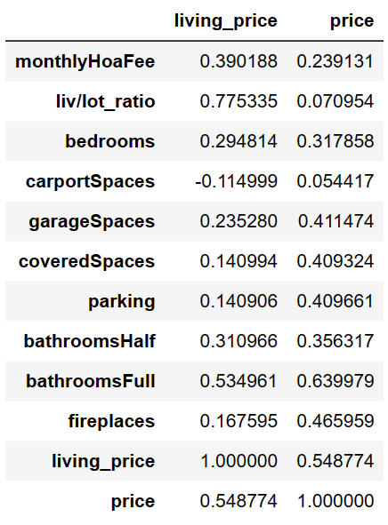
Liv/lot_ratio vs. living price

Slide 6
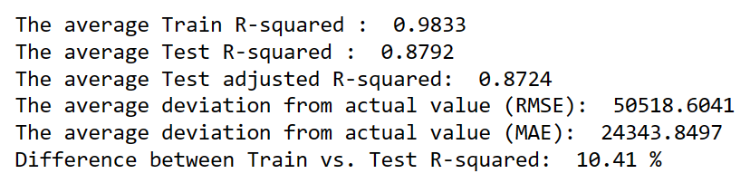
Random forest (raw features)
5-Fold cross validation
No scaled features or target

Slide 7
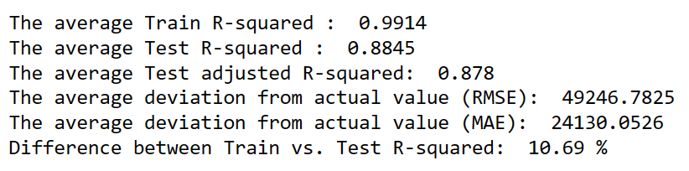
XGB Regressor
5-Fold cross validation
No scaled features or target

Slide 8
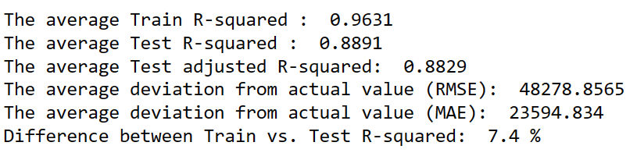
HistGradientboostingregressor
5-Fold cross validation
No scaled features or target
5-Fold cross validation
No scaled features or target

Slide 9
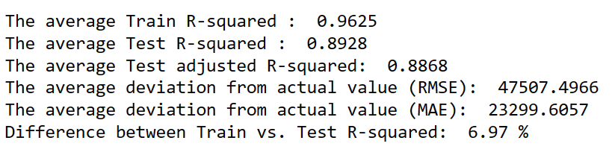
HistGradientboostingregressor (Tuned)
5-Fold cross validation
No scaled features or target
5-Fold cross validation
No scaled features or target

Slide 10

4 final layers have 2000 neurons each layer, with the final 2 layers with dropouts = 0.2
Dense -> ReLu -> Dropout
First layer: 80 neurons
Second layer: 60 neurons
Third layer: 20 neurons
Activation: ‘relu’
ANN ARCHITECTURE

Slide 11
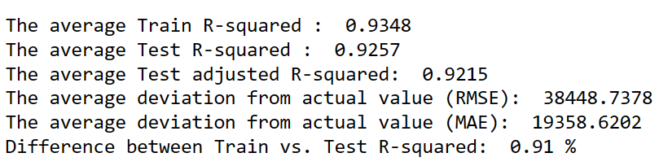
ANN Performance
5-Fold Cross Validation
Scale Numerical Features with MinMaxScaler()
Scale target with np.log
Evaluate the model with np.exp(predictions)

Slide 12
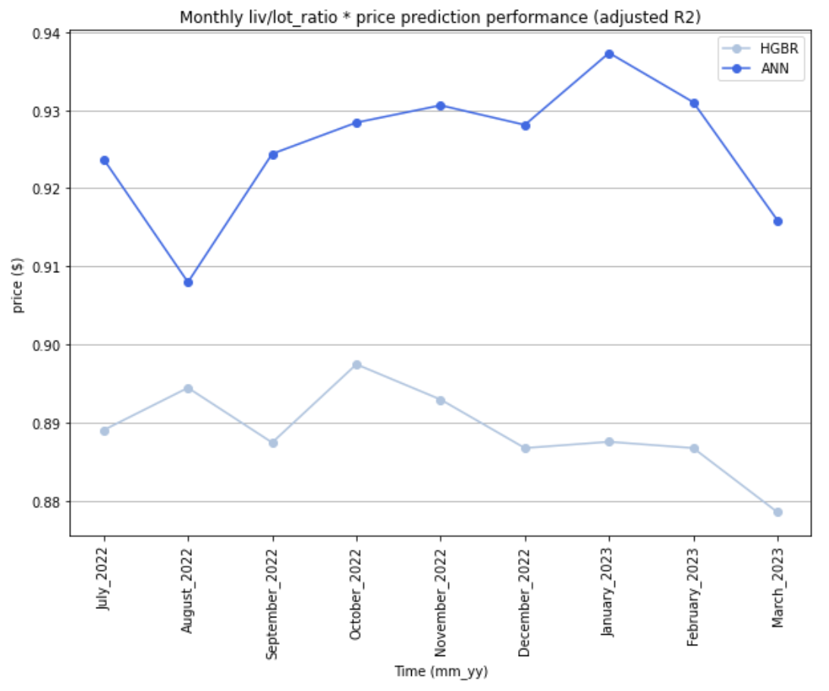
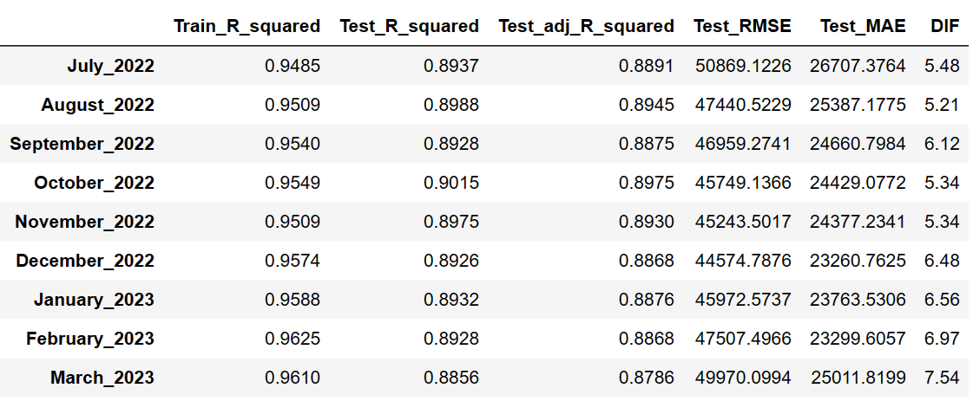
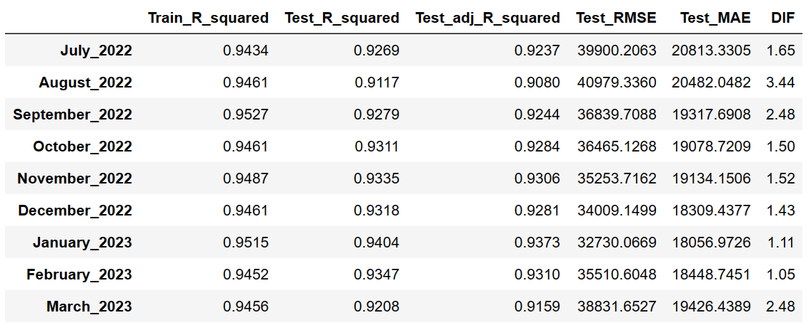
HGBR vs. ANN (Adjusted r2)

Slide 13
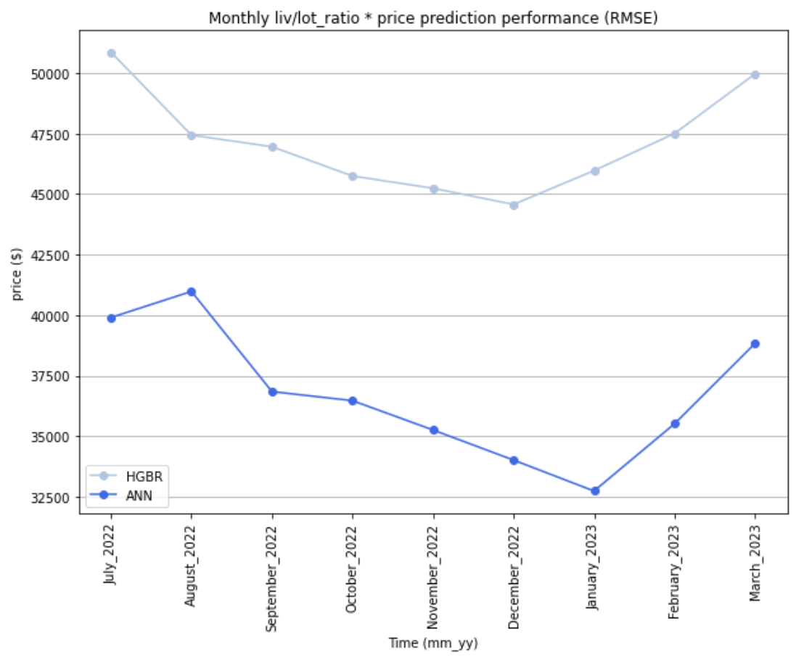
HGBR vs. ANN (RMSE)

Slide 14
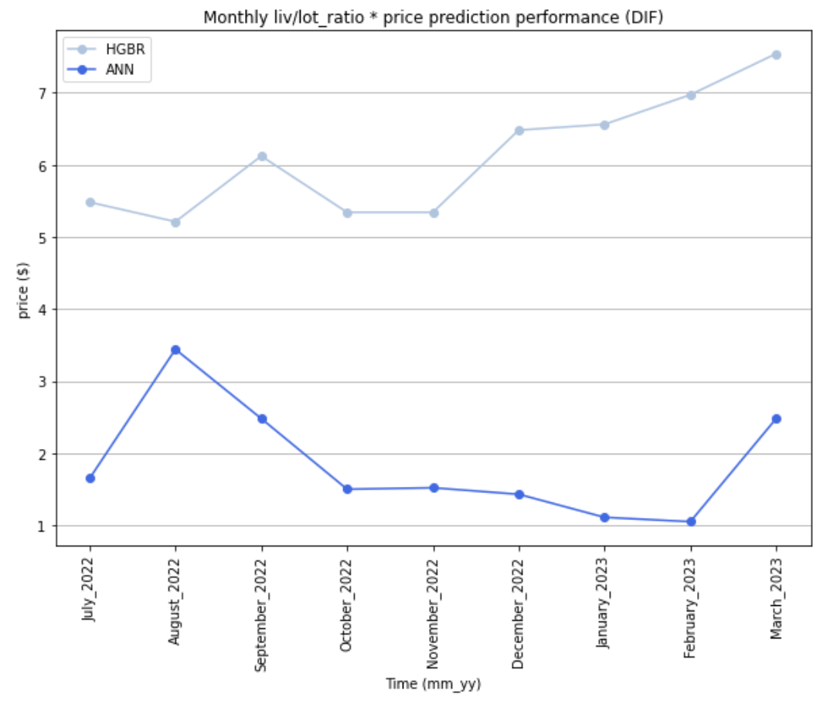
Hgbr vs. ANN (Dif = Abs(Test r-squared – Train R-squared))

Slide 15
HGBR VS. ANN
ANN has higher R-squared and lower RMSE.
ANN generalized better.
=> ANN performs better with properties data.

